Slide 1
Wireless Barcodes for Tagging Infrastructure
Farnoosh Moshir
moshir2@cs.pdx.edu

Slide 2
Outline
Research motivation and problem statement
Concept of wireless barcodes
Challenges
Simulation results
Barcode design and reading algorithm
Barcode prototype
Related work
Summary of contribution and future work

Slide 3
Research Motivation
Embedding information into infrastructure is useful for some applications:
Embedding navigation information into roads
Embedding information into historic sites
Other examples may include bridges, buildings, etc.
Problem statement:
Can information be embedded into infrastructure and be readable for the infrastructure’s lifetime?

Slide 4

Example Application
Barcodes
Imagine a driverless car traveling in foggy condition on a mountain road
Camera based navigation systems will not work particularly well
Likewise, GPS will be blocked in deep valleys as will cellular signals
Barcodes embedded at regular intervals can encode navigation information
E.g., speed, steering angle, begin braking
A reader in the base of the car reads the barcode and enables driving

Slide 5
Example Continued: Design Implications
Properties such barcodes should satisfy:
Last for many years and continue to be readable
Wear and tear should not significantly affect readability
Should be readable through some moisture (thin layer of water or ice)
Inexpensive to produce and have reasonable information density (bits/meter)
As we will discuss later, current technologies such as Optical barcodes, RFID chips and chipless RF tags will not last for years outdoors.
Therefore, we consider barcodes that can be read wirelessly and meet the mentioned properties.

Slide 6
Outline
Research motivation and problem statement
Concept of wireless barcodes
Challenges
Simulation results
Barcode design and reading algorithm
Barcode prototype
Related work
Summary of contribution and future work
Notes:
Based ..

Slide 7
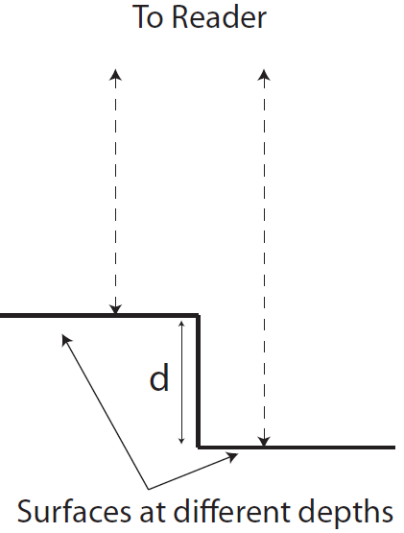
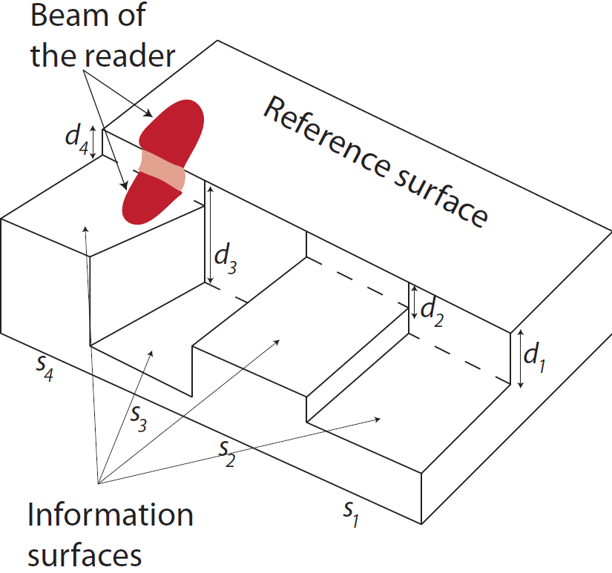
Concept of Wireless Barcodes
Use the time difference of arrival (TDoA) of the signals to encode data.
Note: We are using the reference surface because the distance between the barcode reader and the barcode can vary as a car drives or because of hand shake in a hand held reader.

Slide 8
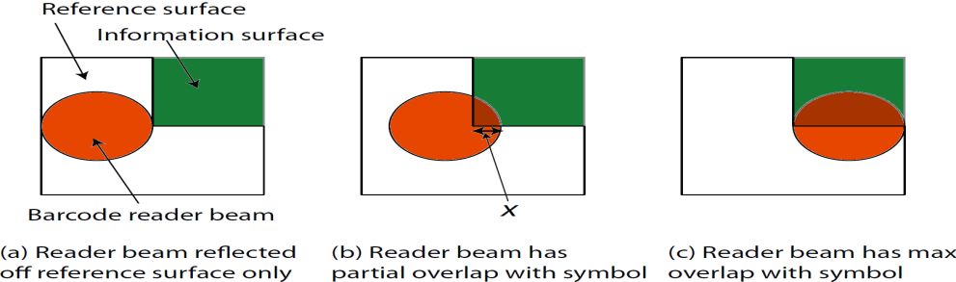
Challenges
Using TDoA, reflected signals should be well separated in time
Roughness of the surface will diffuse the reflected signals
Detecting symbol boundaries

Slide 9
Outline
Research motivation and problem statement
Concept of wireless barcodes
Challenges
Simulation results
Barcode design and reading algorithm
Barcode prototype
Related work
Summary of contribution and future work

Slide 10
Goals of the Simulations
Examine the inter-dependence between
signal intensity
minimum symbol depth
minimum symbol length
Smooth versus rough surfaces,
bandwidth B – 10 GHz and 300 GHz,
For now we assume that the reader beam is narrow – later we study how the reader beam affects barcode symbol size

Slide 11

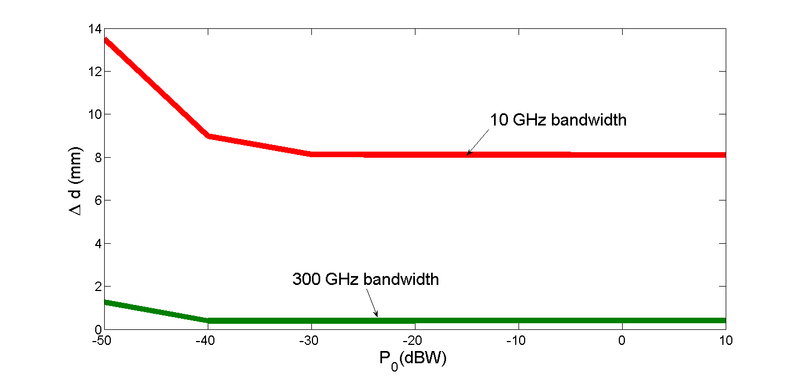
Simulation Results
1- Signal intensity has a significant impact on the minimum symbol depth
2- A larger bandwidth results in smaller symbol depth for all intensity values
For 300 GHz: min symbol depth > 0.4 mm
For 10 GHz: min symbol depth > 8.1 mm

Slide 12


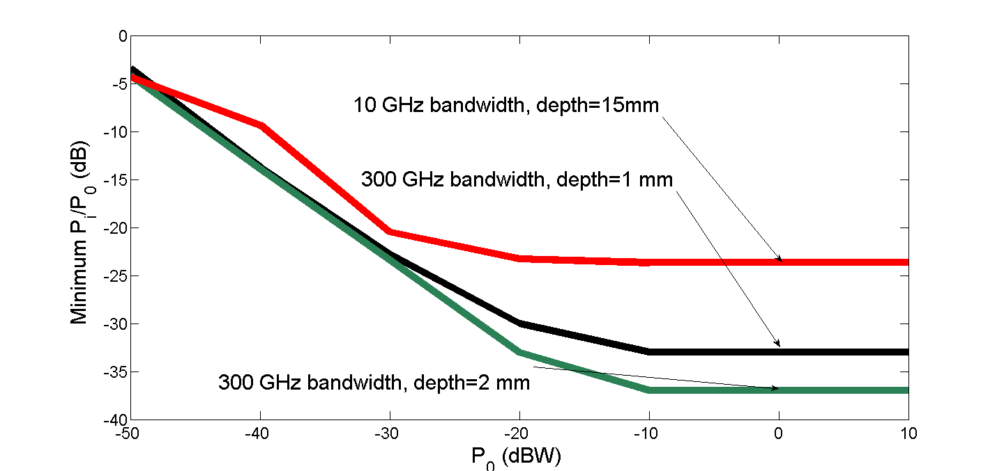
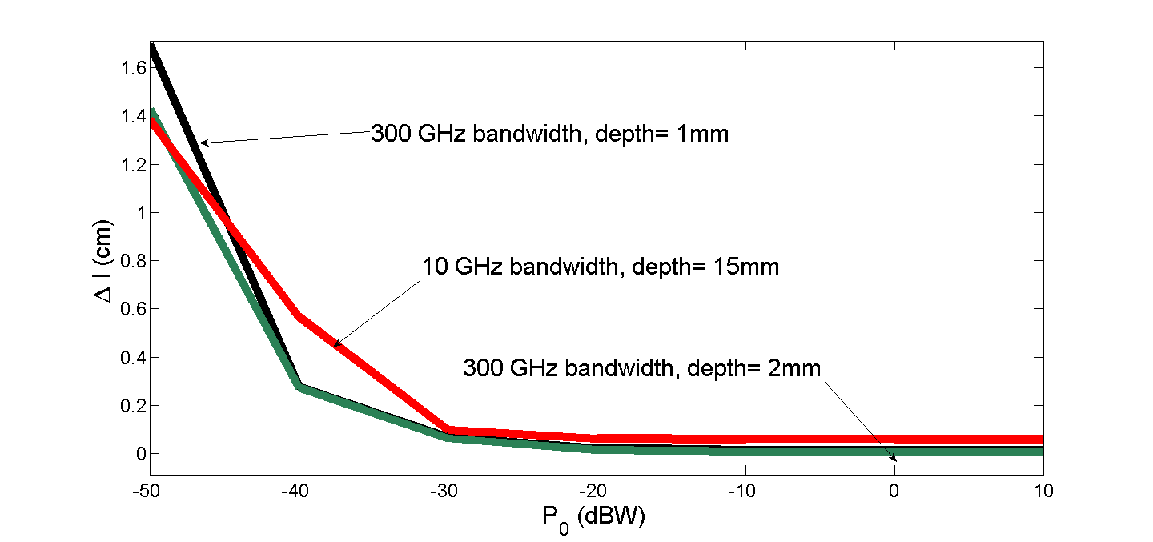
Simulation Results
1- When signal intensity is small we need almost the max beam coverage by the symbol
2- The bigger the depth, the lower relative intensity needed
For 10 GHz bandwidth:
Min symbol length>0.6 mm
For 300 GHz bandwidth:
Min symbol length>0.2mm for d = 1 mm
Min symbol length > 0.1 mm for d = 2 mm

Slide 13
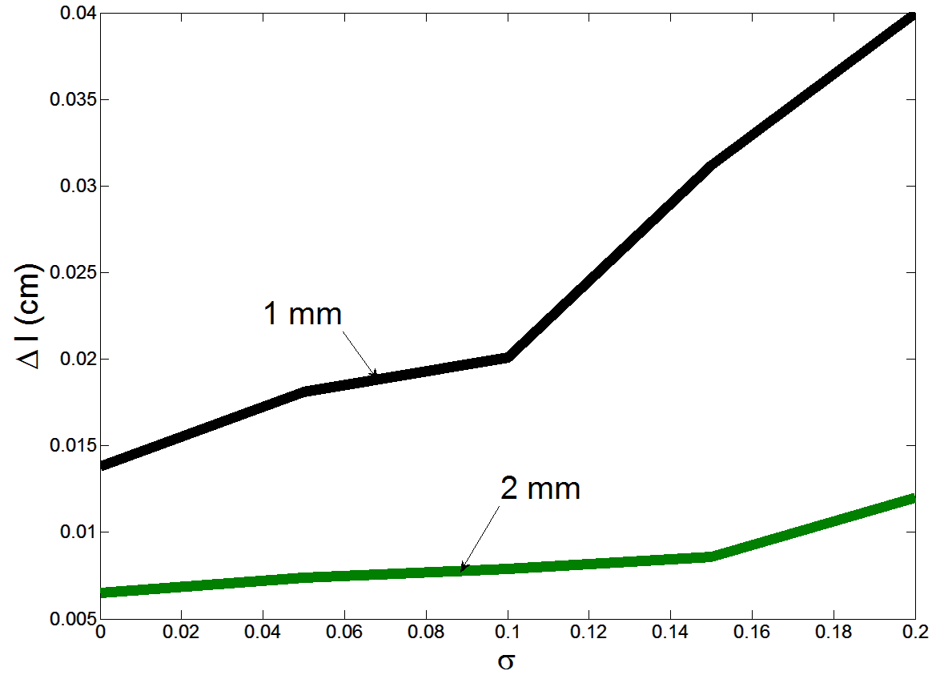
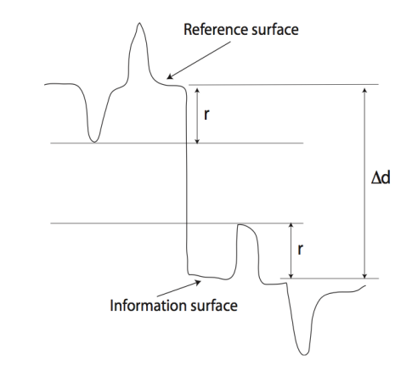
Simulation Results
Roughness of a surface, r, in terahertz frequency is modeled by the following truncated Gaussian distribution:
B = 300 GHz
1- Rough surface causes the reflected signal to spread in time and therefore causes min symbol length to be increased
2- Min symbol length increases faster for depth of 1mm than for depth of 2mm.

Slide 14
Conclusions Based on Simulations
Larger bandwidth is better since we get smaller symbols,
Therefore, we use terahertz signals
Surface roughness requires larger symbols,
We use two materials (cement and copper) in our measurement
Signal intensity is important up to a point
However, our testbed does not allow us to change the intensity
Notes:
BE EXCITED

Slide 15
Outline
Research motivation and problem statement
Concept of wireless barcodes
Challenges
Simulation results
Barcode design and reading algorithm
Barcode prototype
Related work
Summary of contribution and future work

Slide 16
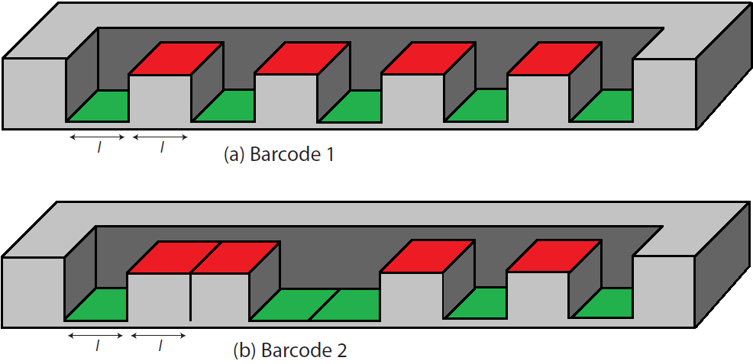
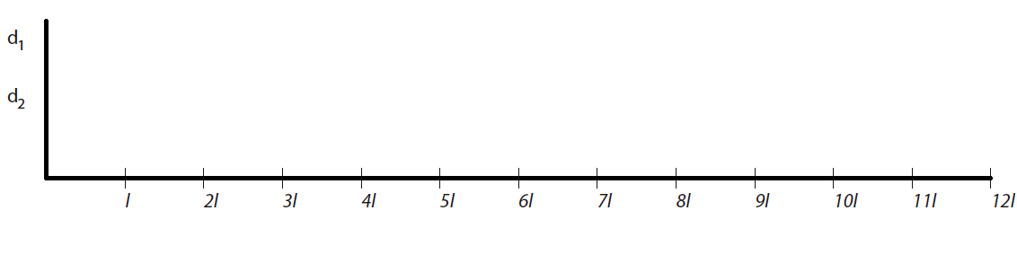
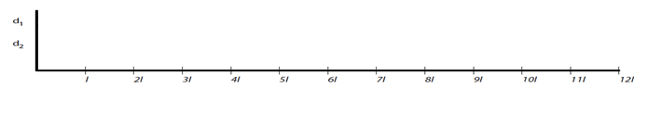
Impact of Reader Beam Diameter
Scan direction
d₂
d₁
d₂
d₁

Slide 17
Theorem1: If we assume that all the symbols have the same length of , then we can uniquely read a barcode if
Barcode reader diameter < 2

Slide 18
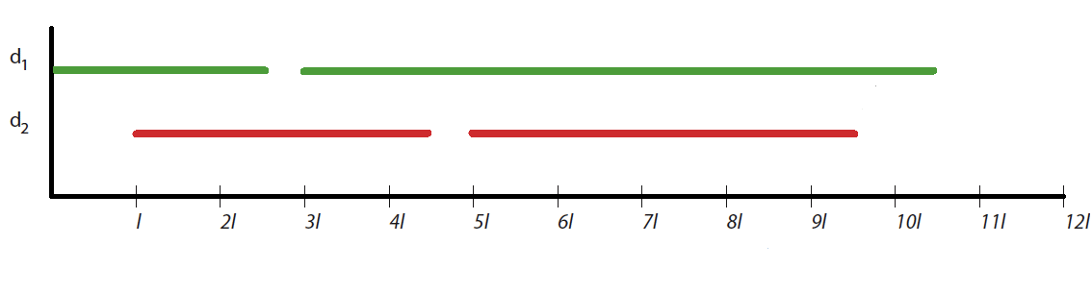
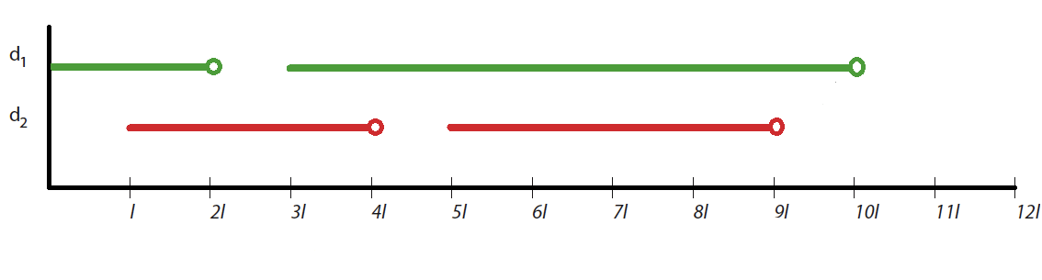
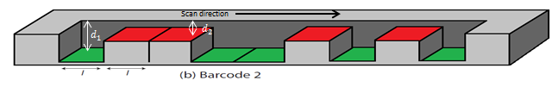
Reading Algorithm
And so on

Slide 19
Outline
Research motivation and problem statement
Concept of wireless barcodes
Challenges
Simulation results
Barcode design and reading algorithm
Barcode prototype
Related work
Summary of contribution and future work

Slide 20
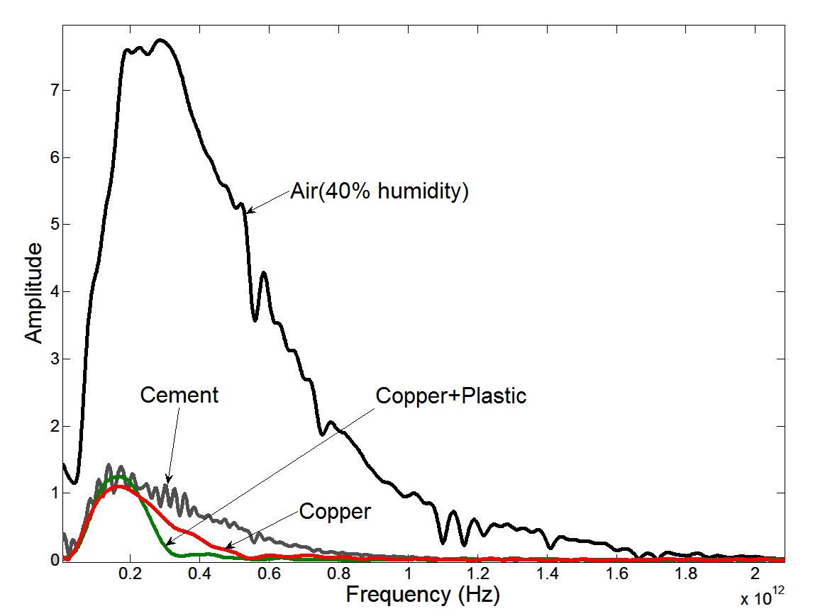
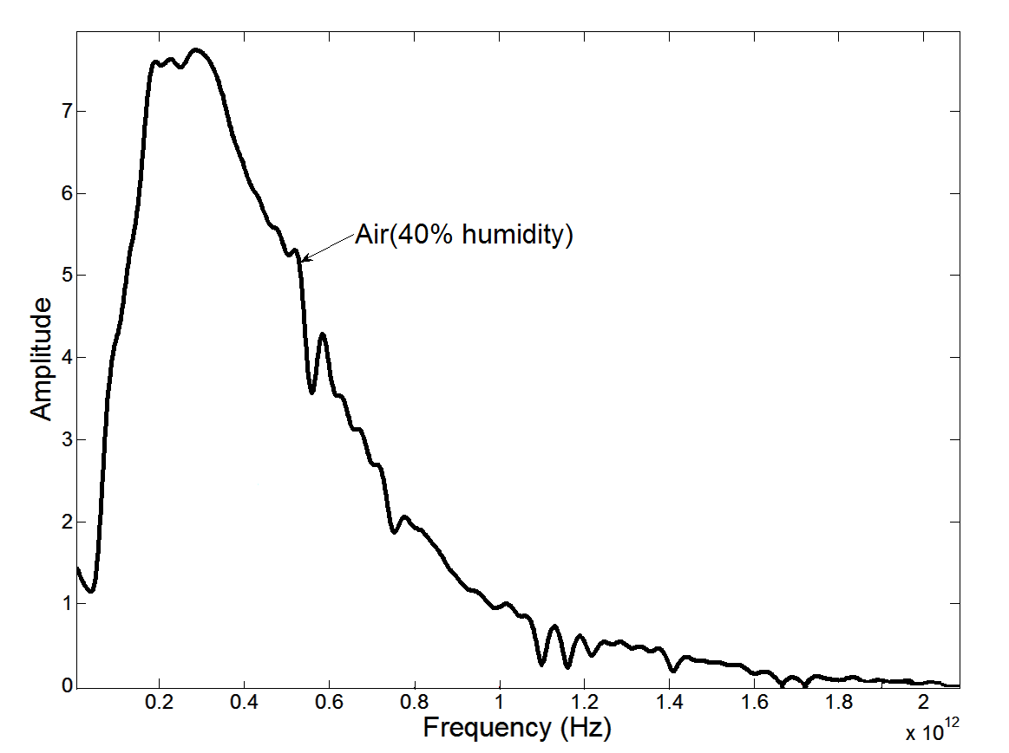
Barcode Prototypes
Used Picometrix system that generates picosecond pulses with 2 THz bandwidth.
We constructed barcode symbols from:
Cement
Copper
Copper + Plastic
Measured the reflected bandwidth
As the signal travel through the air, water absorbs some frequency bands
Cement has a larger bandwidth than copper
Copper+ plastic has the smallest bandwidth
Water absorption lines are absent in selected frequency band.
Humidity does not affect our barcodes

Slide 21
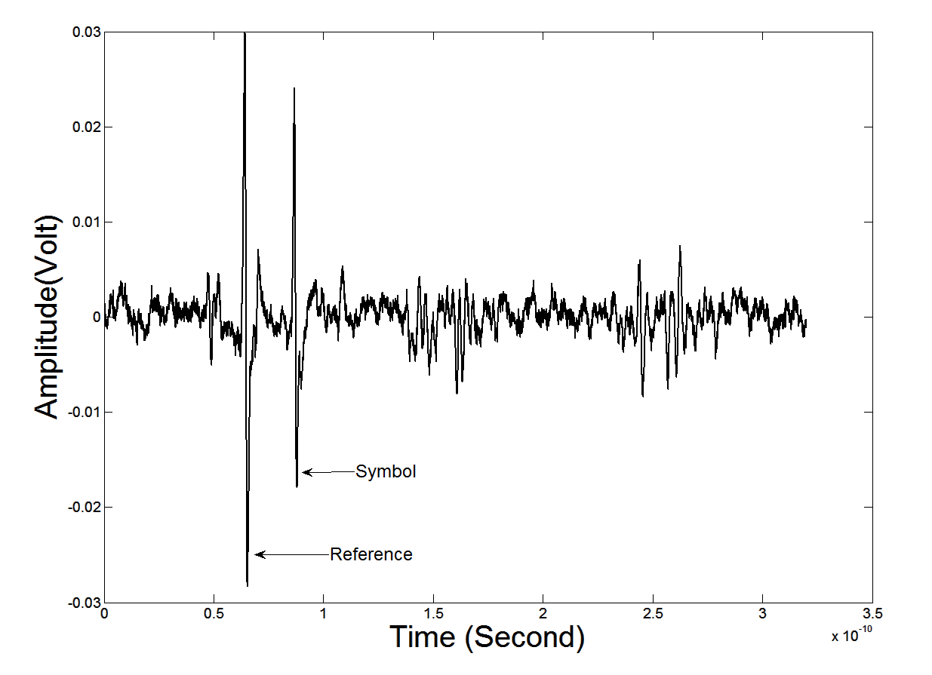
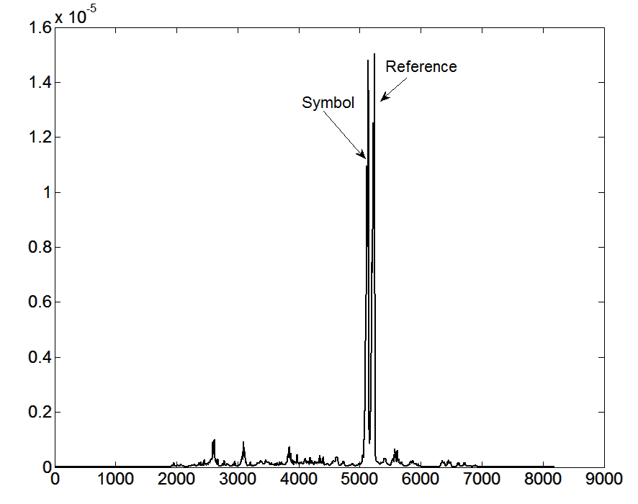
Individual Symbols
Individual cement symbol with depth of 1mm.
Use the same length for all symbols:
Theorem 2: Given N random bits to encode, using the same length for all symbols gives the minimum barcode length or greatest symbol density (bits/meter)
Symbol length of 1 cm.
The reader receives the time domain reflection from the barcode.
We calculated the correlation of the received signal with the reference signal.

Slide 22
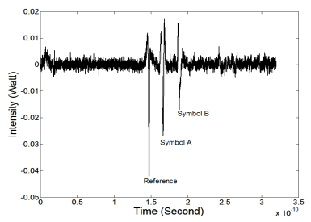
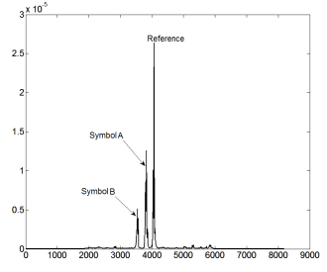
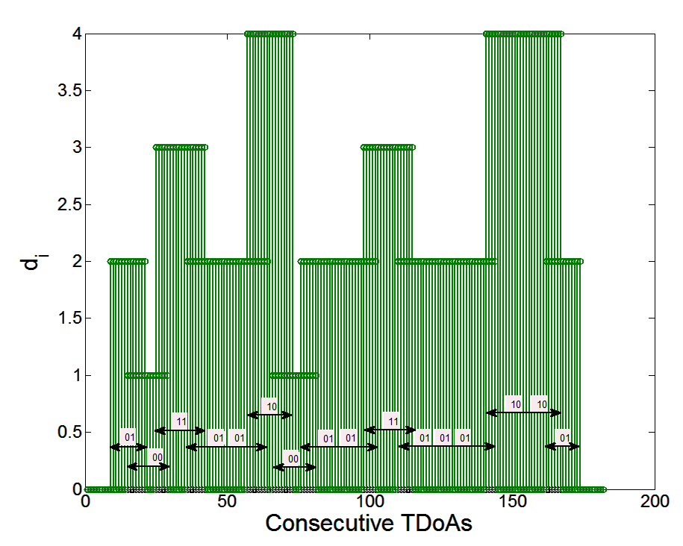
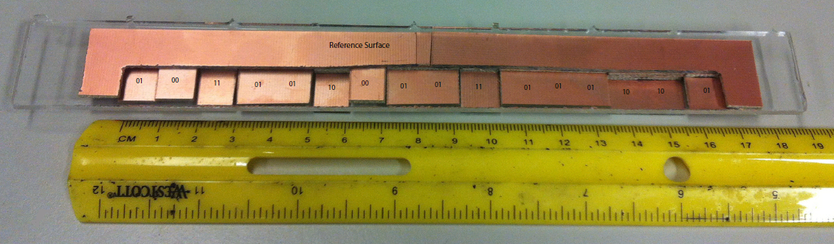
“Maui” Copper Barcode with Plastic Cover
“Maui” ➔ standard ASCII encoding
Assigned 2 bits per symbol:
00: 1
01: 2
11: 3
10: 4
16 symbols

Slide 23
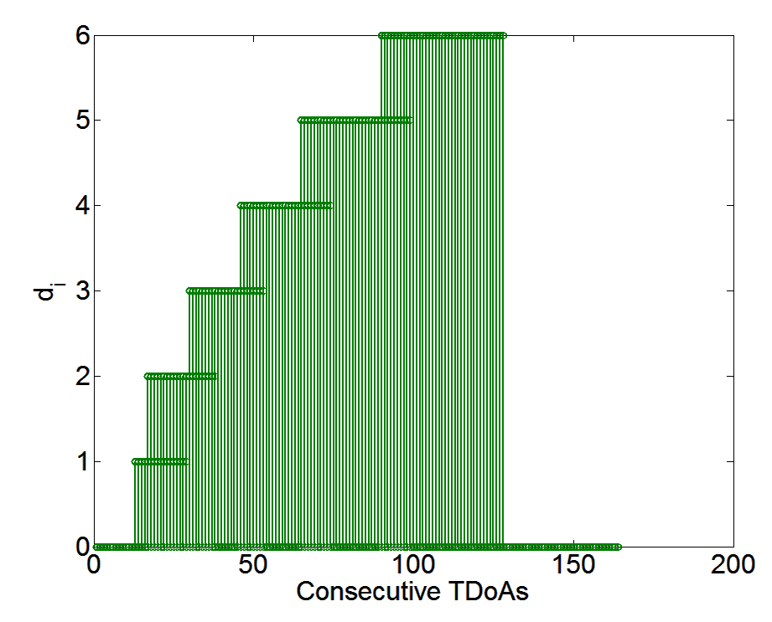
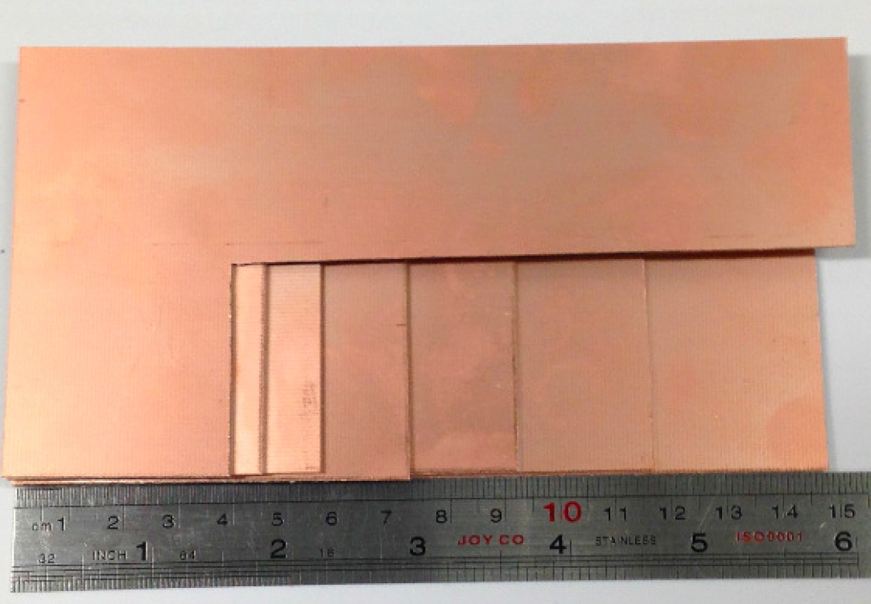
Reading a Wet Barcode
Created a new barcode
Covered the barcode with roughly 1mm layer of water
We were able to read barcode correctly
Humidity does not affect our barcode

Slide 24
Outline
Research motivation and problem statement
Concept of wireless barcodes
Challenges
Simulation results
Barcode design and reading algorithm
Barcode prototype
Related work
Summary of contribution and future work

Slide 25

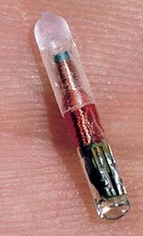
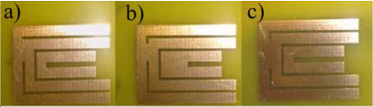
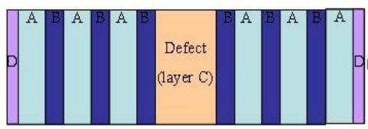
Related Work
Optical Barcodes
Encode data by altering the reflection intensity
Not durable
Not good for outdoor usage
RFID (Radio Frequency Identification)
Stores information electronically
Not durable
Chipless RFID Tags (RF Tags)
Low capacity
Not durable
Terahertz Tags
Periodic structure of two dielectrics with different refractive index
Tag should be placed between reader’s transmitter and receiver
Low capacity
Error prone
Not durable
http://en.wikipedia.org/wiki/File:UPC-A-036000291452.png
http://en.wikipedia.org/wiki/Radio-frequency_identification
Vena et al. 2012
Tedjini et al. 2010

Slide 26
Summary and Future Work
Summary
We built a new type of barcodes
Contain no electronic components and can be built with different materials
Durable and robust to the ravages of time
Can be embedded into infrastructure
It is hard to destroy these barcodes
Future Work
Test other materials
Can add another dimension to the barcode by using different materials that have unique terahertz frequency spectrum

Slide 27
Thank you

Slide 28
References
Li, G., Arnitz, D., Ebelt, R., Muehlmann, U., Witrisal, K., Vossiek, M.: Bandwidth dependence of CW ranging to UHF RFID tags in severe multipath environments. In: IEEE International Conference on RFID. (2011) 19–25
Tedjini, S., Perret, E., Deepu, V., Bernier, M., Garet, F., Duvillaret, L.: Chipless tags for RF and THz identification. In: 2010 Proceedings of the Fourth European Conference on Antennas and Propagation (EuCAP), IEEE (2010) 1–5
Vena, A., Perret, E., Tedjini, S.: Design of compact and auto-compensated single- layer chipless RFID tag. IEEE Transactions on Microwave Theory and Techniques 60(9) (2012) 2913–2924

Slide 29
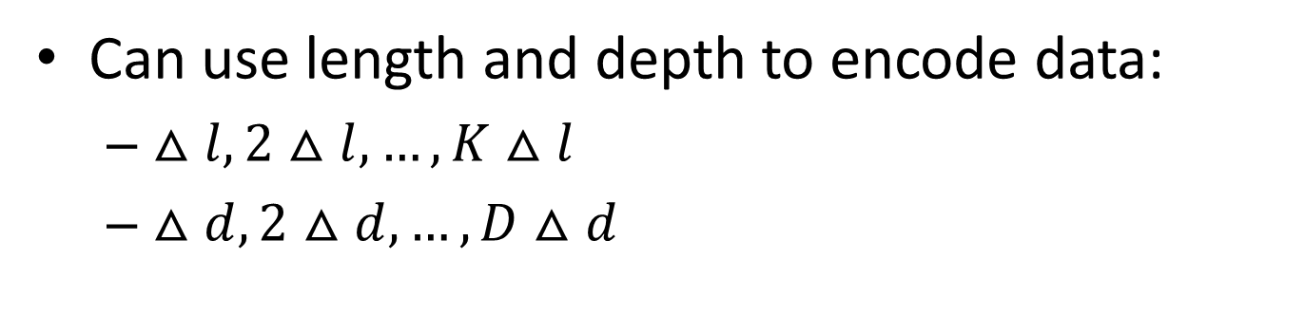
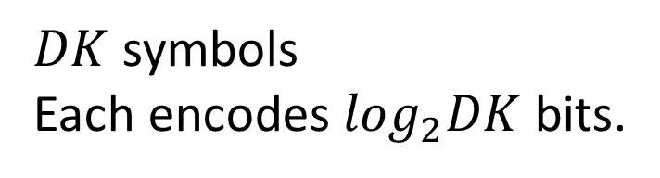
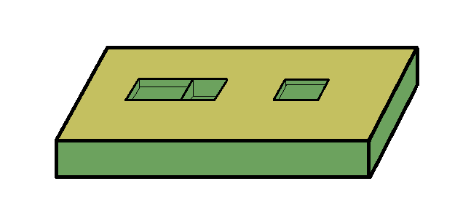





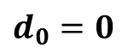
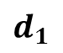
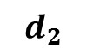
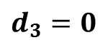
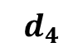
Encoding Data

Slide 30
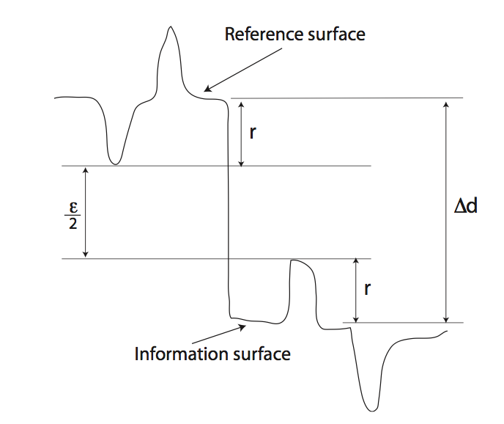
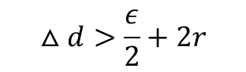
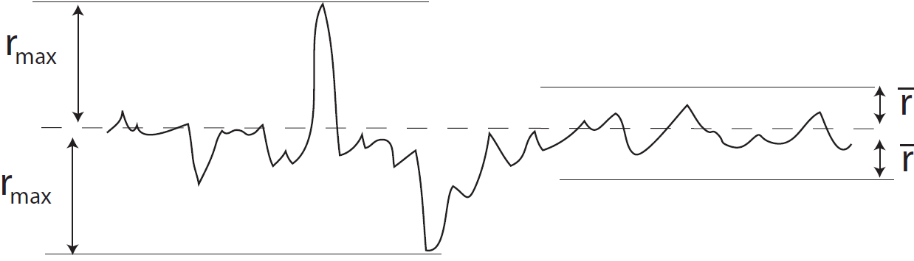
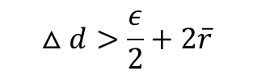
Challenges
Surface roughness effects

Slide 31
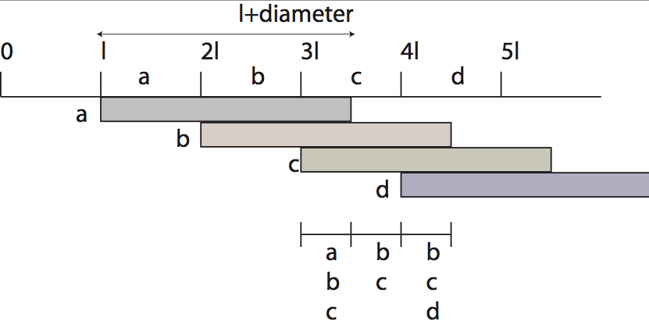
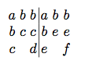
Theorem1
Theorem1: If we assume that all the symbols have the same length of , then we can uniquely read a barcode if
Barcode reader diameter < 2
Proof: Consider the above barcode.
Lets assume that a different barcode with symbols a,b,e,f gives the same TDoA signature and the first symbol where these two barcodes differ is at symbol c.
The TDoA signature of the two barcodes are:
To have the same TDoA signature we should have: a,b,c = a,b,e
This will never happen, unless c=e.
Therefore, it is impossible to construct different barcodes that yield the same TDoA signature if Barcode reader diameter <

Slide 32
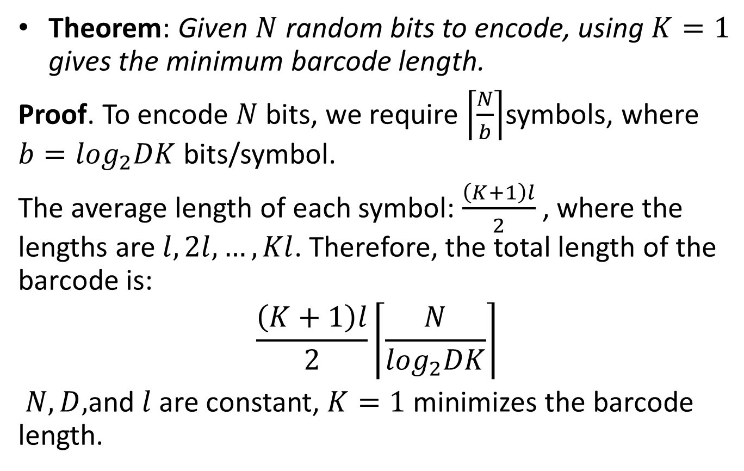
Theorem2

Slide 33
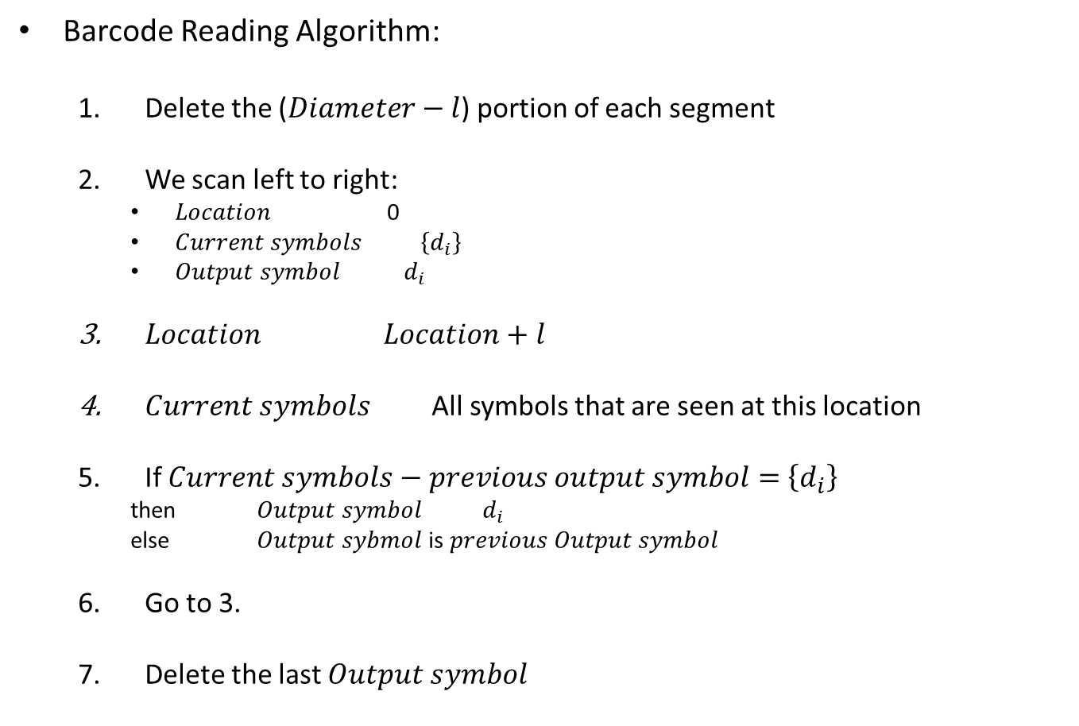
Reading Algorithm

Slide 34


Individual Symbols
Copper symbols with depth of 2 and 4 mm:

Slide 35
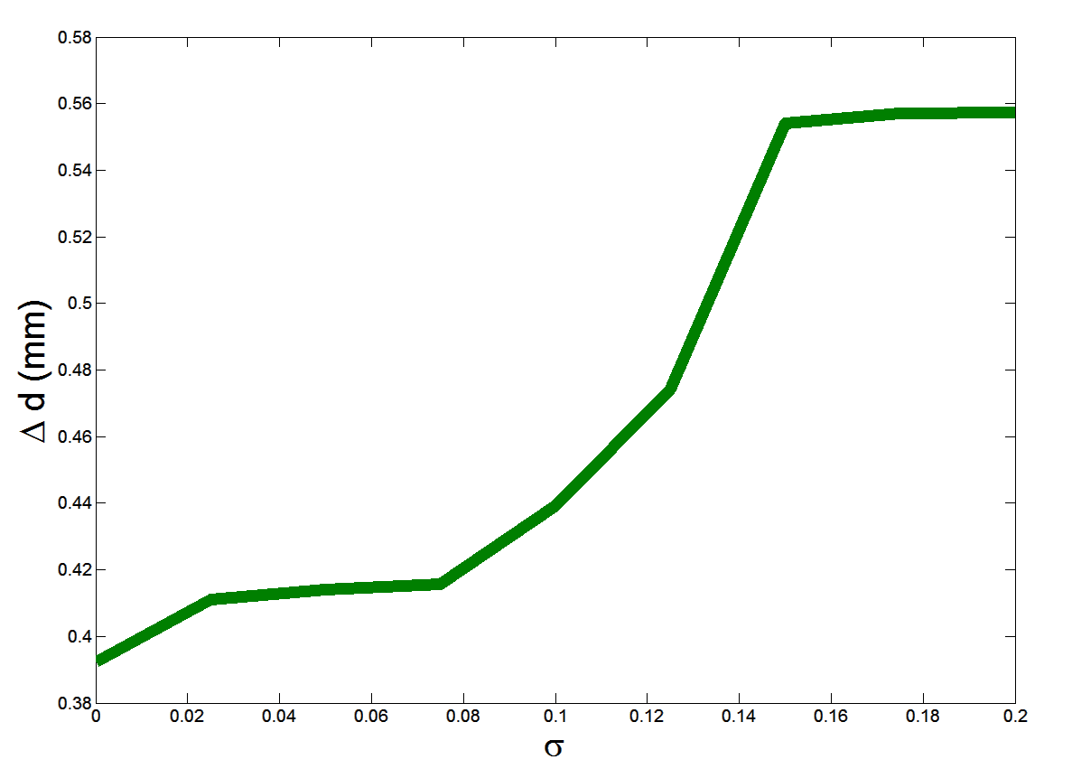
Simulation Results
Roughness of a surface, r, in terahertz frequency is modeled by the following truncated Gaussian distribution:
B = 300 GHz
Notes:
Take out second plot and make it a backup
Remove delta d from title
Move roughness figure below and larger - animate

Slide 36

Min symbol length
Newton Method:
Notes:
Take out second plot and make it a backup
Remove delta d from title
Move roughness figure below and larger - animate

Slide 37
Reading Algorithm
And so on

Slide 38
Impact of Reader Beam Diameter
Scan direction
d₂
d₁
d₂
d₁
Notes:
Say that the reader scans left to right
Need to explain the green and red lines of first plot better
Show how you read 2 symbols at once

